Slide 1
Exoplanets

Slide 2
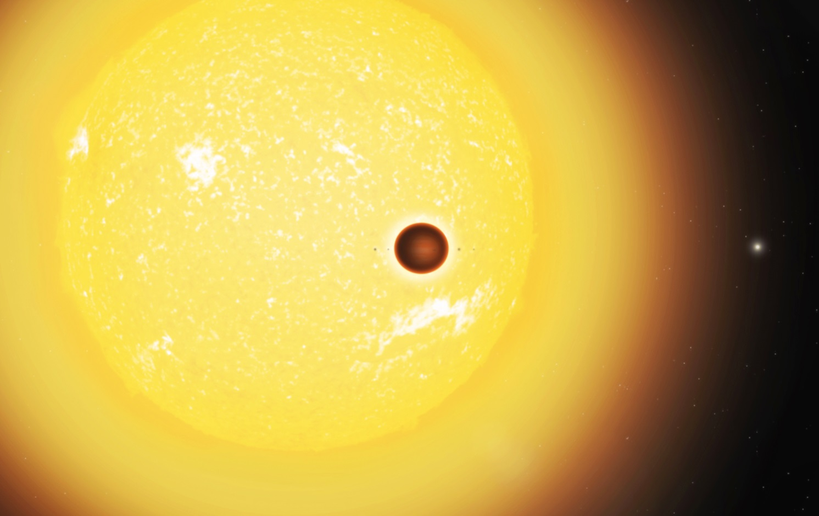
What is an exoplanet?

Slide 3
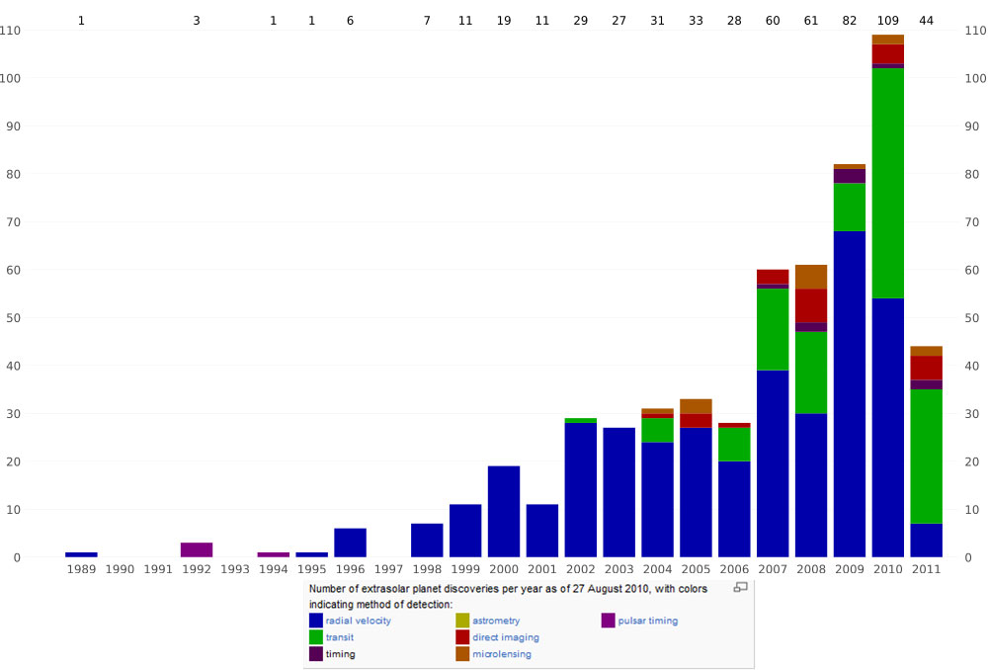
How do we detect them?

Slide 4
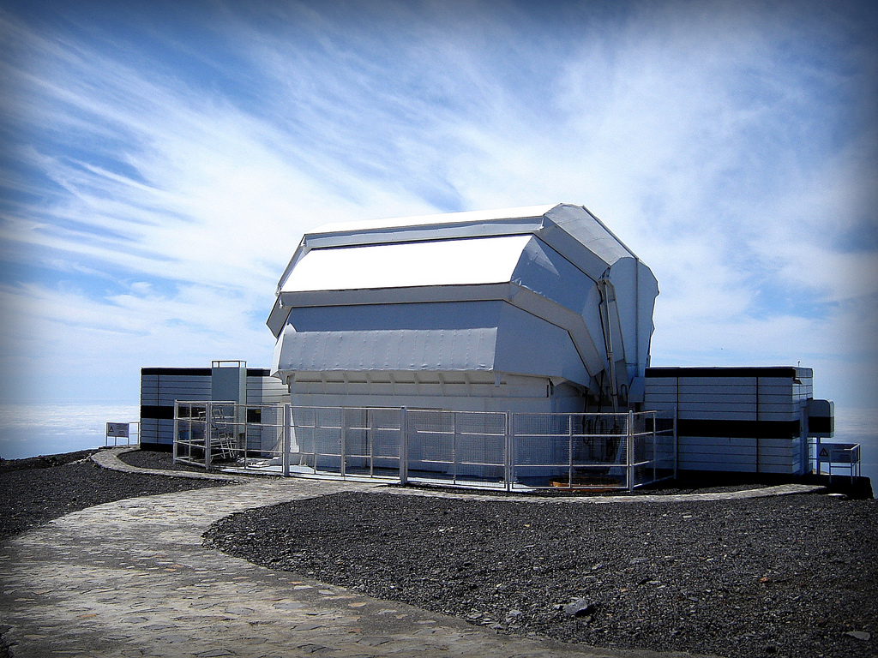
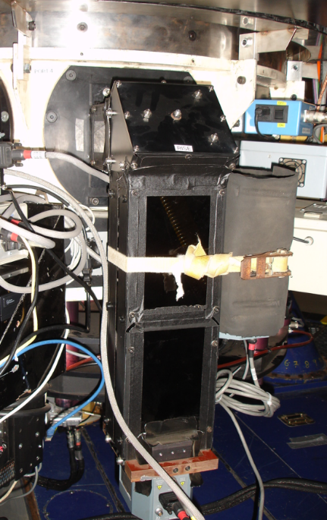
RISE
Liverpool Telescope

Slide 5
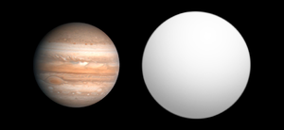
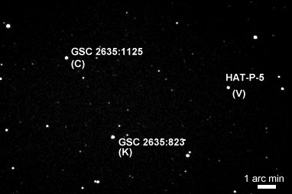
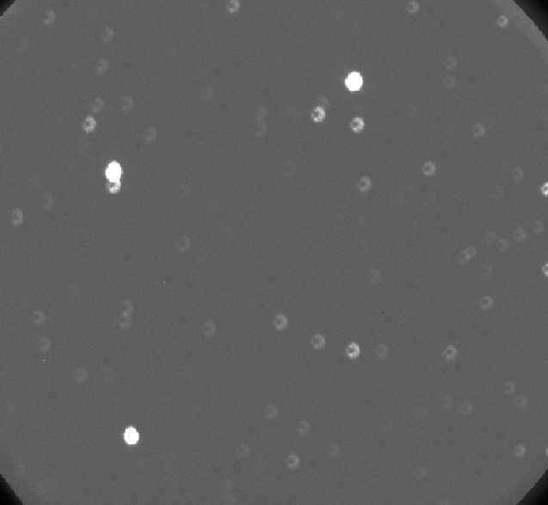
Hat-P-5

Slide 6
Our results
 | HAT-P-5 | Constant Star Counts | Transit Line (Straight Lines) | Time Cumalative | Time
q_e_20090709_4_1_1_1 | 499667.3 | 1228312.5 | 0.406791676 | 0
q_e_20090709_4_11_1_1 | 490650.9 | 1225387.4 | 0.400404721 | 160 | 160
q_e_20090709_4_21_1_1 | 495177 | 1235791.3 | 0.400696299 | 321 | 161
q_e_20090709_4_31_1_1 | 499409.7 | 1234851.5 | 0.404428954 | 481 | 160
q_e_20090709_4_41_1_1 | 496996.2 | 1241902.8 | 0.40018929 | 641 | 160
q_e_20090709_4_51_1_1 | 496423.8 | 1235182.3 | 0.401903266 | 802 | 161
q_e_20090709_4_61_1_1 | 497740.1 | 1234698.3 | 0.403126902 | 962 | 160
q_e_20090709_4_71_1_1 | 499080 | 1231049.1 | 0.405410312 | 1122 | 160

Slide 7
Summary

Slide 8
References
Photos:
1) http://www.link2universe.net/wp-content/uploads/2011/05/exoplanet_hotjupiter.jpg. [Accessed 02 July 2015].
2) Astrometry | The Planetary Society. 2015. Astrometry | The Planetary Society. [ONLINE] Available at: http://www.planetary.org/explore/space-topics/exoplanets/astrometry.html. [Accessed 02 July 2015].
3) The Liverpool Telescope : Telescope + Instruments : Instruments : RISE. 2015. The Liverpool Telescope : Telescope + Instruments : Instruments : RISE. [ONLINE] Available at: http://telescope.livjm.ac.uk/TelInst/Inst/RISE/. [Accessed 02 July 2015].
4) https://upload.wikimedia.org/wikipedia/commons/thumb/8/83/Exoplanet_Comparison_HAT-P-5_b.png/300px-Exoplanet_Comparison_HAT-P-5_b.png. [Accessed 02 July 2015].https://www.google.co.uk/url?sa=i&rct=j&q=&esrc=s&source=images&cd=&cad=rja&uact=8&ved=0CAcQjRw&url=http%3A%2F%2Fwww.richweb.f9.co.uk%2Fastro%2Fextrasolarplanet_stars.htm&ei=YjaVVbisDszg7QaCt7TYAg&bvm=bv.96952980,d.ZGU&psig=AFQjCNH2iG-bg-_i6zre8Rj2aq3dcFUhHw&ust=1435928543563931. [Accessed 02 July 2015].
Written:
1) Exoplanets: Worlds Beyond Our Solar System . 2015. Exoplanets: Worlds Beyond Our Solar System . [ONLINE] Available at :http://www.space.com/17738-exoplanets.html. [Accessed 02 July 2015].
2) HubbleSite - NewsCenter - The Milky Way Contains at Least 100 Billion Planets According to Survey (01/11/2012) - The Full Story. 2015.HubbleSite - NewsCenter - The Milky Way Contains at Least 100 Billion Planets According to Survey (01/11/2012) - The Full Story. [ONLINE] Available at: http://hubblesite.org/newscenter/archive/releases/2012/07/full/. [Accessed 02 July 2015].

